Slide 1
IoT Environmental
Monitoring System
Using LoRaWAN, MQTT
and Node-RED
Project 8
Daniel Anselm (Purdue) Juyeon Jung (CAU)
Gaeun Kim (CAU) Sungho Lee (CAU)
Hyemin Lim (CAU)
1

Slide 2
IoT Environmental Monitoring System Using LoRaWAN, MQTT and Node-RED
Problem Statement
Unpredictable weather is causing problems for agriculture [1].
Many prior studies have developed a smart farm system with IoT technology, but it has the limitation that it can be used only in a confined space like greenhouses or urban farming [2].
construct IoT weather monitoring system for vast land
( American farms )
[1 ]K. Sivanraju, “IoT in Agriculture : Smart Farming,” IJSRCSEIT, vol.3, no.8, pp.181-184, 2018.
[2] N. V. Dharwadkar and R. K. M. Math, “IoT Based Low-cost Weather Station and Monitoring System for Precision Agriculture in India,” International Conference on I-SMAC (IoT in Social, Mobile, Analytics and Cloud), 2018, pp. 81-86

Slide 3
IoT Environmental Monitoring System Using LoRaWAN, MQTT and Node-RED
Project Goal
monitor & maintain various sensor data by using Node-Red platform
manage the long-distance data transmission by using LoRa and MQTT protocol
use Solar Power so farmers don't need to replace batteries and run cables for all station

Slide 4
Our footprints
1st Demo
Project goal
Research
2nd Demo
Big picture
3rd Demo
UI : Node-Red
4th Demo
Components
5th Demo
Hardware Assembly
Network Setup
Final Demo
Hardware : RAK3244
MQTT
LoRaWan
Breadboard
Node-Red & DB
And today..
Realtime Data
E-mail notification

Slide 5
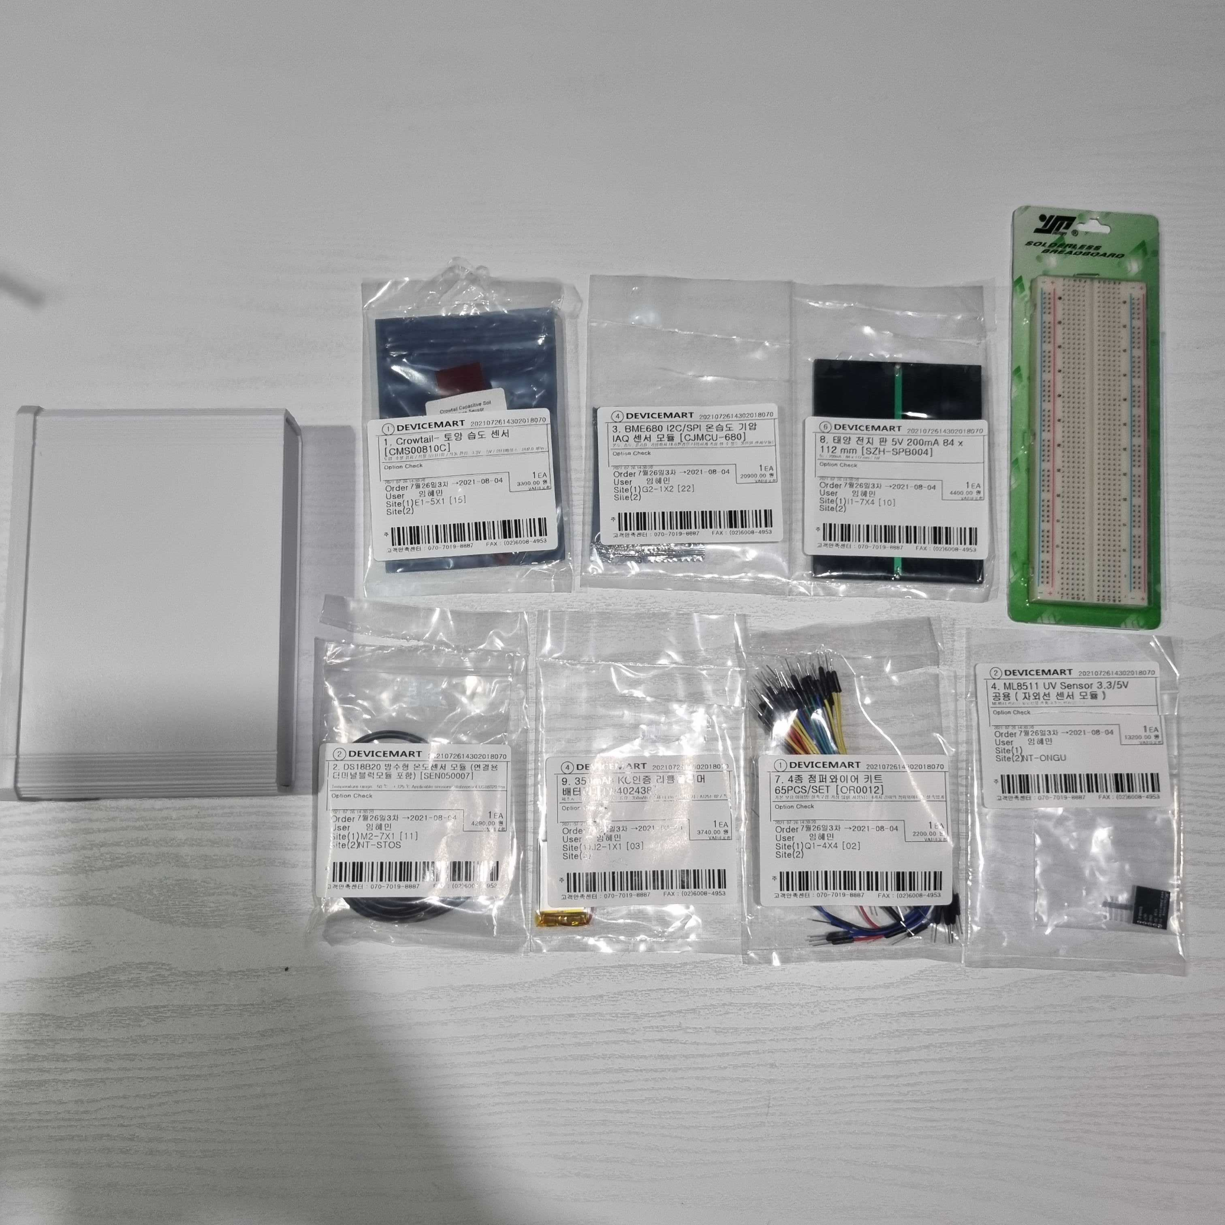









Hardware - components
LoRa Gateway
Soil Moisture Sensor
Temperature Humidity Barometric Pressure IAQ Sensor Module
Solar Panel
Breadboard
Waterproof Temperature Sensor
Lithium Polymer Battery
Wire
UV Sensor Module
+ Enclosure Box

Slide 6
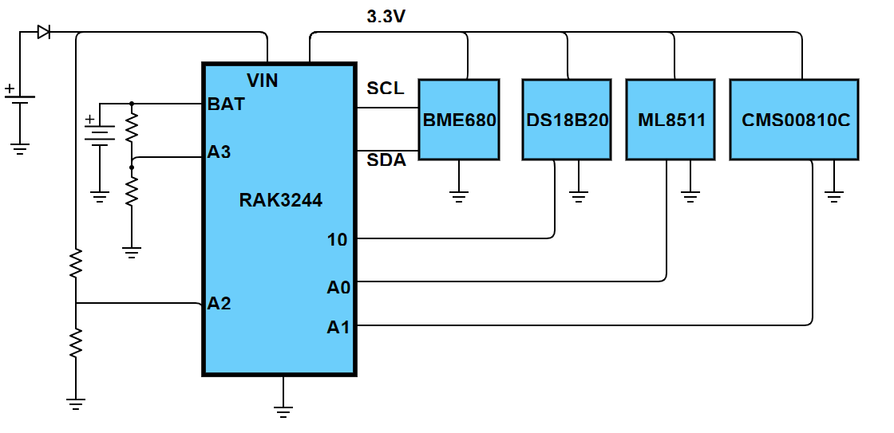
Hardware
schematic diagram

Slide 7
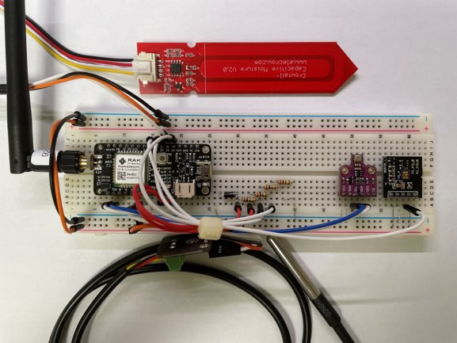
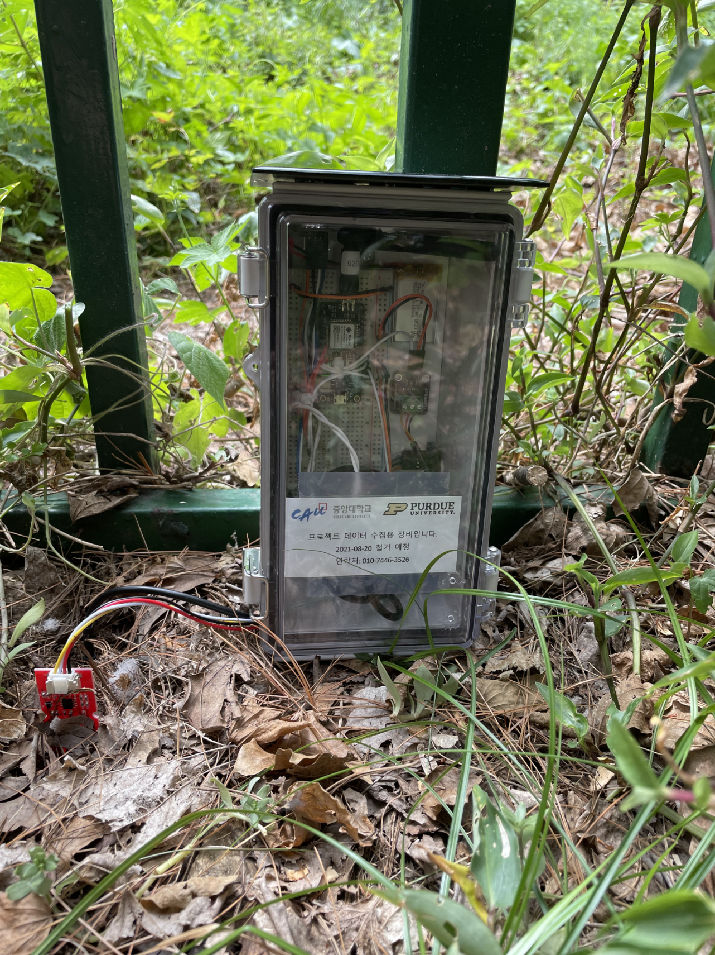
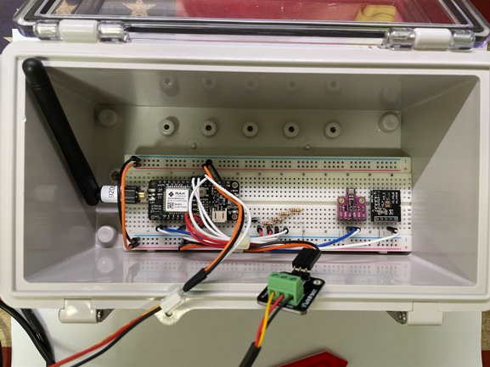
Hardware

Slide 8


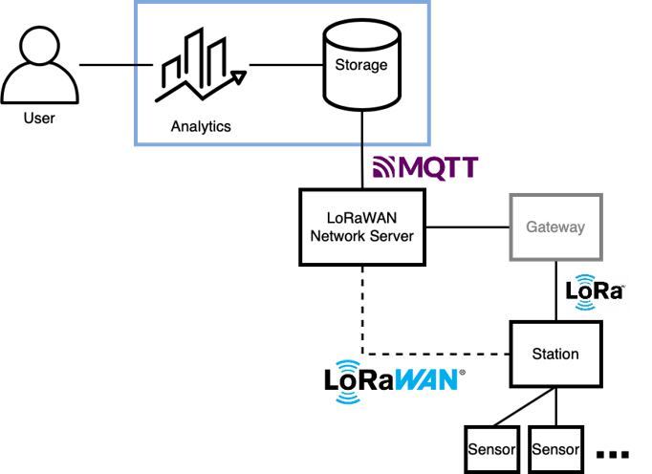

Software

Slide 9

Software

Slide 10
Software
Network
Modified library [3]
to support KR920 frequency
[3] Beelan-LoRaWAN. (ver. 2.0.0). Beelan. Accessed: Aug. 19, 2021. [Online]. Available: https://github.com/BeelanMX/Beelan-LoRaWAN

Slide 11
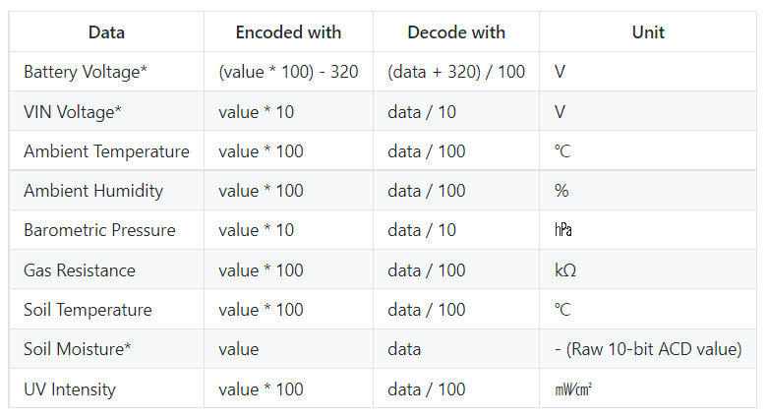
Software
Data packet encoding
Voltages : 8-bit unsigned integer
Temperature Sensors : 16-bit signed integer
Other Sensors : 16-bit unsigned integer

Slide 12
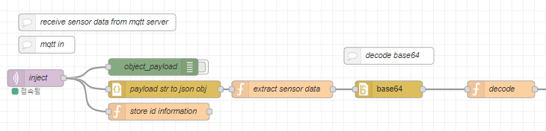
Software
Decode base64

Slide 13
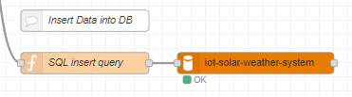
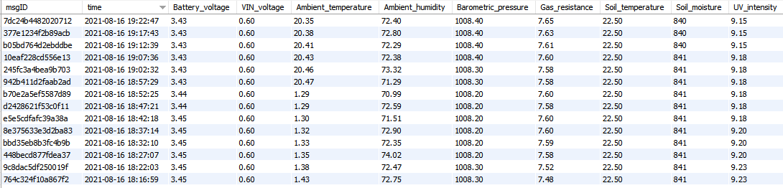
Software
Data Storage
Store data to DB

Slide 14
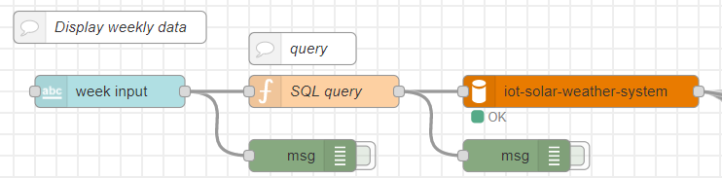
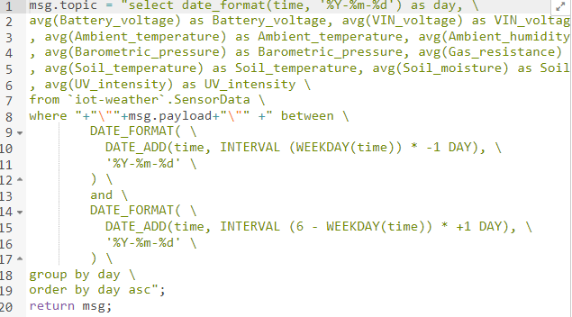
Software
Data Storage
Get data from DB

Slide 15
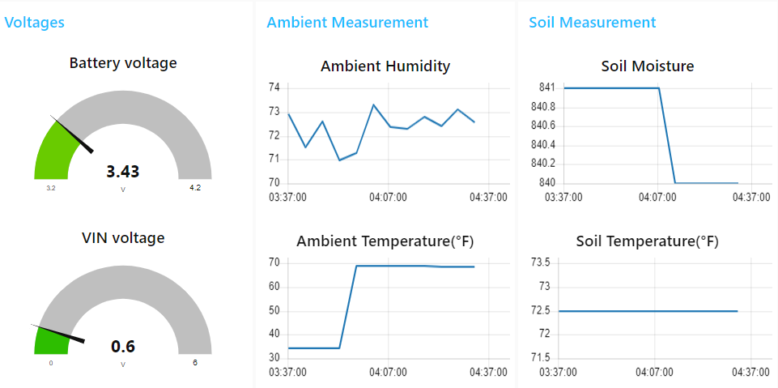
Software
UI

Slide 16
Demo
Recorded video

Slide 17
Limitations
Struggling
Support KR920 frequency
Unstable NodeRED
Making query

Slide 18
Limitations
Limitations
User input is not flexible.
Limited UI implementation
Only have one station
Fixed time zone
Battery life
Inaccurate data
Notes:
<content>
Inaccurate data - Not using stevenson screen, slide19, slide20
On NodeRED, for the user input part, there are some exceptions.
(history data page - have to pick start day first,
Setting page – have to enter both higher than and lower than condition & It's hard to know if it's been entered correctly,
Setting page – only avaiable to enter (℃), ….)
E-mail – cannot use address given from use.. Have to mannually enter the address.

Slide 19
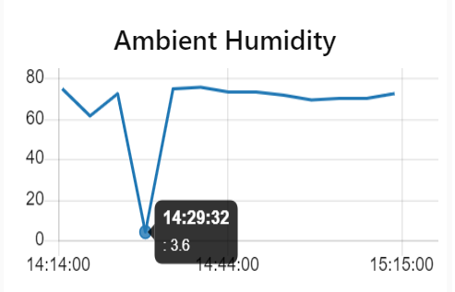
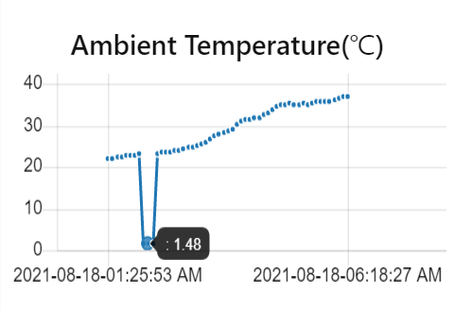
Limitations
Limitations
Sometimes the station sends data values that are way out of normal range
-> Compare it to the most recently added data value
-> If the difference between them goes over certain degrees, don't display or store it to the database
Notes:
<content>
On NodeRED, for the user input part, there are some exceptions.
(history data page - have to pick start day first,
Setting page – have to enter both higher than and lower than condition & It's hard to know if it's been entered correctly,
Setting page – only avaiable to enter (℃), ….)
E-mail – cannot use address given from use.. Have to mannually enter the address.

Slide 20
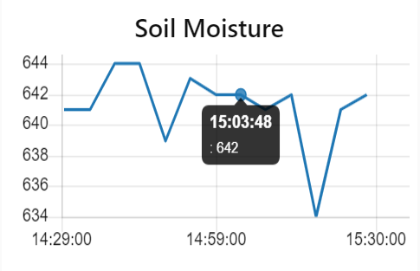
Limitations
Limitations
Soil moisture sensor measures the moisture level by the electric capacitance. If the soil is dry, output will be higher. [4]
So if the value is high, it means that the soil is dry. This is not intuitive to the user.
-> We can set up a calibration system using principles of the tensiometer to get more accurate values. [5]
[4] Electropeak, "Complete Guide to Use Soil Moisture Sensor w/ Examples", Arduino Project Hub, 2019. [Online]. Available : https://create.arduino.cc/projecthub/electropeak/complete-guide-to-use-soil-moisture-sensor-w-examples-756b1f. [Accessed: Aug. 18, 2021]
[5] ltrium, "Soil Moisture Sensor Calibration", Instructabales, 2020. [Online]. Available: https://www.instructables.com/Soil-Moisture-Sensor-Calibration/. [Accessed: Aug. 18, 2021]
Notes:
<content>
On NodeRED, for the user input part, there are some exceptions.
(history data page - have to pick start day first,
Setting page – have to enter both higher than and lower than condition & It's hard to know if it's been entered correctly,
Setting page – only avaiable to enter (℃), ….)
E-mail – cannot use address given from use.. Have to mannually enter the address.

Slide 21
Future Plans
Future Plans
improve previous limitations
simple & easy UI

Slide 22
Thank You

